Slide 1
Statewide Substance Use Response Working Group Meeting
January 19, 2022
Notes:
9:00
Slides Up
Broadcasting Zoom
AG Ford to Welcome

Slide 2
1. Call to Order and Roll Call to Establish Quorum
Notes:
AG Ford to call meeting
--
Emma Rodriguez
“I will now call the roll”
Please indicate if you are present
AG Ford, We do (or do not) have a quorum)

Slide 3
2. Public Comment
(Discussion only.)
Notes:
AG Ford to invite public comment. Slides provide directions.
9:05

Slide 4
Public Comment
Public comment shall be limited to three (3) minutes per person. We will begin with comments from Las Vegas and then invite comments from Carson City, followed by online participants.
In Person
Please form a line.
Before commenting, please state your full name for the record.
Notes:
Limit public comment timing –
Vegas
Carson
Online
--

Slide 5
Public Comment
Attending Online
Please use the “raise hand” feature to indicate you would like to provide public comment so the host can prompt you to unmute.
If you are dialing in from a telephone and would like to provide public comment, please press *9 so the host can prompt you to unmute.
Before commenting, please state your full name for the record.
*Comments can also be emailed to lhale@socialent.com. These comments and questions will be recorded in meeting minutes.
Notes:
Limit public comment timing –
Vegas
Carson
Online

Slide 6
3. Review and Approve Minutes for November 16, 2021 SURG Meeting
(For Possible Action.)

Slide 7
4. Annual Report on the Use of State and Local Money to Address Substance Misuse and Substance Use Disorders
(For Possible Action.)

Slide 8
5. Review Initial Findings and Provide Feedback for the Statewide Needs Assessment for the Advisory Committee for Resilient Nevada
(For Possible Action.)

Slide 9
Statewide Substance Use Working Group (SURG)
Placeholder for optional client logo
Needs Assessment
State of Nevada
January 19, 2022
Dr. Courtney Cantrell, PhD Jordan Bublik, MS Kathy Nichols, LCSW

Slide 10
01
Background and Methodology
02
Opioid Impact
03
Risk Factors
04
Polysubstance, Co-Occurring Conditions, Suicide Impact
05
Current and Potential Resources/Programs
06
Next Steps, Future Directions, & Questions
Agenda

Slide 11
Background and Methodology
1

Slide 12
Nevada’s Substance Use History
Significant Events and Efforts
2016 – Statewide Opioid Response
Statewide Opioid Conference is held
Legislation developed to curb prescribing (AB474)
Influx of federal funding for response efforts
2011–2015
Overdoses on the Rise
Nevada reaches second highest prescribing rates of Hydrocodone/Oxycodone
2017 – Continued Response
Implemented DEA HIDTA's ODMAP
2018 – Meth and Fentanyl
Use of meth and fentanyl rapidly increases
2019 – Polysubstance Climbs
ODs due to opioids with stimulants begin to increase
2020 – COVID-19 Complications
Sharp increase in polysubstance ODs
Increase in illicit pill consumption
Now

Slide 13
Needs Assessment
2020 Clark County Community Perceptions of Drug Use & Harm Reduction Survey Report
Adverse Childhood Experiences Special Report
Coordination Task Force 2022 Operational & Planning Framework
Forensic Toxicology and Nevada’s OD Surveillance System Needs Assessment
Formative Research to Investigate Barriers & Facilitators to Accessing Services Among Current & Former Opioid Users in Nevada Report
Nevada High Intensity Drug Trafficking Area 2021 Threat Assessment
Nevada Perinatal Health Initiative & SUPPORT Act
Nevada Public Health Crisis Response
Nevada State Opioid Response Grant II 2019 Annual Report
Nevada Substance Abuse Prevention & Treatment Agency Capacity Assessment Report
Nevada SUD & OUD Treatment and Recovery Services Provider Capacity Expansion Strategic Plan
Nevada Vulnerability Assessment
Nevada’s Sustainability Plan to Support Expansion of SUD & OUD Treatment & Recovery Provider Capacity
NV-OD2A: Hispanic Latinx OD; OD Landscape; OD Surveillance Quarterly Report; Polysubstance Trend Report State and Regional Reports; Suspected Nevada Drug OD Surveillance Monthly Report
Opioid Response Summit Final Report 2019
ODMAP Report by Nevada Counties
SUD & OUD in Nevada: Policy Analysis and Infrastructure Assessment Report
Inputs
State Agency
Input
CDC – NV-OD2A
DHHS
HIDTA
Attorney General Office
Southern Health District of Nevada
Seminal Documents
Needs Assessment
Data Sources
441A Mandated Hospital OD Reporting
Coroner/Medical Examiners Office
Criminal History Repository Electronic Death Registry System Harm Reduction Organizations
HIDTA’s Overdose Data Mapping Application Program Hospital Billing Data
National Forensic Laboratory Information System
Prescription Drug Monitoring Program
State Unintentional Drug Overdose Reporting System Syndromic Surveillance
Treatment Episode Data Set
Legislation
SB390
SUPPORT Act

Slide 14
Opioid Impact
2

Slide 15
Opioid Impact
Statewide Statistics
Nevada ranks nationwide:
Twenty-eighth in opioid overdose (OD) deaths (2019)
Twentieth in Opioid prescribing (2020)
From 2019–2020:
Opioid-related OD deaths increased by 76%
Use of fentanyl increased by 227%
Opioid-related emergency department encounters increased by 26%
Self-Reported use of heroin and other opioids among pregnant women has quadrupled since 2004
Neonatal opioid exposure has more than doubled since 2010

Slide 16
Opioid Impact
Statewide Statistics – 2020 OD Deaths
ODs Increased 55% from 2019–2020
788 Overdose Deaths (ODs) Occurred
Age
55-64 years: 20.6%
45-54 years: 20.1%
25-34 years: 18.9%
Race/Ethnicity
White: 64.3%
Hispanic: 19.9%
Black 14.0%
Sex
Male: 68.3%
Female: 31.7%
Education
HS/GED: 53.7%
Bachelors: 6.5%
Masters: 1.2%
Mental Health
Current SUD: 77.7%
Mental Illness: 34.5%
Previous OD: 11.9%
Route of Administration
Ingested: 44.4%
Smoked: 21.0%
IV: 16.0%
Other
Contributing Drugs:
Meth: 47.7%
Benzo: 21.3%
Alcohol: 12.3%
65.2%
of ODs
Involved
Opioids
Opioid Type
Fentanyl: 30.4%
Heroin: 16.7%
Prescription: 20.3%
ODs with an Opioid and…
Stimulants: 26.6%
Benzo: 18.9%
Alcohol: 9%
BH Region
Clark: 68.8%
Washoe: 21.1%
Northern: 4.7%
Setting
Home: 76.6%
Bystander Present: 56.2%
Other:
Homeless: 8.9%
Military: 6.6%

Slide 17
Opioid Impact
Region and Counties
Regions
Counties
Northern Nevada (2019–2020)
Accidental/undetermined intent drug overdoses reported 391
61% of overdose deaths had opioids listed in the cause of death
20% overdose deaths had an opioid and stimulant present
Overdose deaths due to fentanyl increased by 164%
Southern Nevada (2019–2020)
Accidental/undetermined intent drug overdoses reported 907 — 68% increase
66% of overdose deaths had opioids listed in the cause of death
Overdose deaths due to fentanyl increased by 257%
Overdose deaths due to benzodiazepines increased by 146%
Top Five Counties with Highest number of suspected OD (2021)
Clark
Washoe
Nye
Top Five Counties with Highest rate of Opioid-related OD deaths
Churchill
Lyon
Humboldt
4. Douglas
5. Elko
4. Lincoln
5. Carson City

Slide 18
Health Equity
In Nevada
Nearly 9% of the population under age 65 have disabilities
Over 12% live in poverty
11% of residents are uninsured
48% or the population is minority
Over 30% speak a language other than English at home
Nevada has the largest percentage of uninsured unauthorized immigrants in the region
Nevada has 27 federally-recognized tribes
97% of Nevada's tribal nations are rural
1.1% of the State’s population is American Indian Alaskan Native (AIAN)
30% of Nevada’s AIAN lives in poverty
Nevada has only 11 SUD providers per 1,000 adults with addictions compared to the national average of 32 per 1,000.
Hispanics face higher rates of overdose deaths
Overdose deaths of Hispanics increased by 120% from 2019–2020

Slide 19
Opioid Availability
Nevada is a target rich environment for drug trafficking and money laundering to include major transportation highways, shared borders with major drug trafficking areas like California and Arizona, tourism, gaming, manufacturing, etc.
Initially, the pandemic slowed the pace of drug trafficking into the United States; however, the threat of illicit drugs — including the rates of overdoses — persisted as traffickers adapted and drug compositions like fentanyl became more potent. Additionally, during the lockdown, drug dealers were able to turn to the Dark Net to sell and purchase drugs and other illicit commodities.
Nevada HIDTA assesses with high confidence that opiates (fentanyl and heroin) will continue to be a high drug threat to its AOR with a 196% increase in fentanyl overdose deaths between 2019 and 2020, surpassing heroin as a top drug threat.

Slide 20
Risk Factors
3

Slide 21
System-Level Risk Factors
Prevention Programming (lack of unified, statewide prevention programming with established outcomes measurement, drug education and school-based interventions)
Harm Reduction (needle exchanges statewide)
Access to Treatment (transportation, housing, lack of providers, lack of referrals, lack of quality evidence-based treatment, stigma, education regarding treatment option, data to monitor quality, access and capacity)
Recovery Support (parent education, employment support, housing)

Slide 22
Individual-Level Risk Factors
Behavioral health issues
Low-income
Minority populations
Homelessness
Veterans
Individuals with I/DD
Individuals with chronic diseases
Youth
Trauma/accidents
Victims of domestic abuse/sex trafficking
Lack of vocational opportunities
Chronic pain
Criminal justice involvement, especially release from prison or jail
ACEs and child welfare
Lack of educational opportunity
Chronic pain disease
Health care not well-coordinated

Slide 23
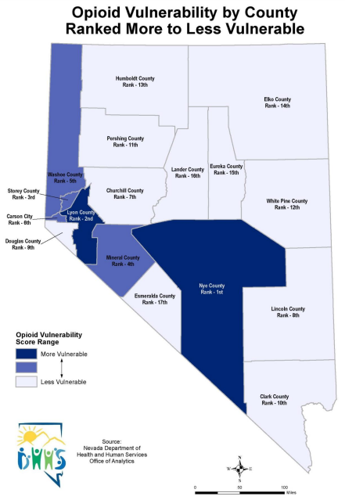
Nevada Vulnerability Assessment
Top 6 Most
Vulnerable Counties
Nye
Lyon
Storey
Mineral
Washoe
Carson City
Assessment Criteria
Socioeconomic Indicators
Per capita annual income
Percentage of:
Population who live below the poverty level
Noninstitutionalized population who are uninsured
Households with no access to a vehicle
Population who are ages 25 and greater without a high school diploma
Unemployment rate of persons ages 16 years and greater
Infectious Disease Indicators
Count of new HIV cases, HIV incidence and prevalence rates
Rate of HIV incidence through IDU transmission, sexually transmitted infections (STI), acute hepatitis B, and hepatitis C virus
Drug Use Indicators
ED visit rate: opioid, methadone, methamphetamine, and heroin-related visits
Inpatient admission rate: opioid, methadone, methamphetamine, and heroin-related admissions
Opioid prescription rate: prescriptions greater than 90 MME rate
Mortality rate: methamphetamine and heroin-related deaths
Source: DHHS Nevada Vulnerability Assessment from January 2020

Slide 24
Polysubstance, Co-Occurring Disorders, Suicide Impact
4

Slide 25
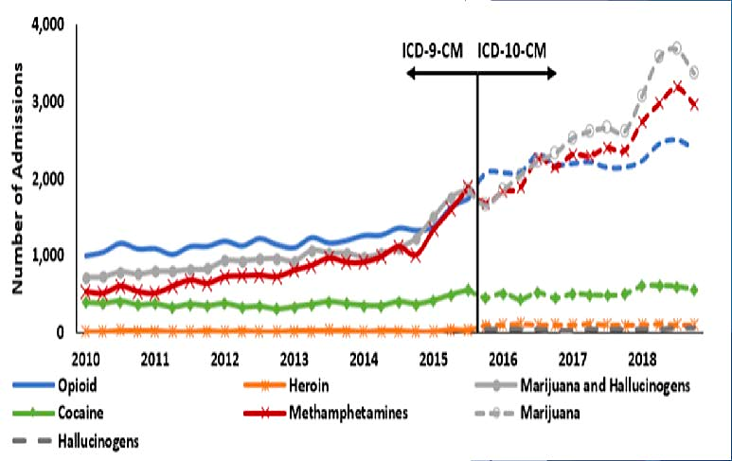
Polysubstance Use
Approximately 400,000 need, but do not receive treatment for SUD. Nevada's most pressing need is to increase the number of treatment services available to residents across the State
OD deaths for heroin and methamphetamine use increased in Clark (29%) and Washoe (89%) counties (2015–2018)
In 2020, 26.6% of overdoes deaths were due to a combination of opioids and stimulants
Source: NV-OD2A Prevention & Intervention Efforts in Nevada presentation on July 7, 2021

Slide 26
Co-Occurring Conditions
Behavioral and Physical Health
Behavioral Health
Physical Health
Mental Illness
34.5% individuals had a fatal OD had a mental health problem prior to OD deaths in 2020
Approximately 75% of mentally ill criminal offenders had a co-occurring SUD in 2018
Suicide
9.9% of individuals had a fatal OD had a history of suicidal thoughts, plans, or attempts prior to ODs in 2020
Nevada ranked sixth on the CDC’s list of suicide mortalities among United States in 2018
Nevada’s teen suicide rate among 15–19 year olds is 13.5 per 100,000 people in 2018
Nevada’s military veterans’ rate of suicide is 47 for every 100,000 people in 2018
Sexually transmitted infections (chlamydia, gonorrhea, syphilis)
HIV/AIDS
Hepatitis A, B, C
Reported in 2018: 77 acute new cases of hepatitis A and 85 acute new cases of hepatitis C
Increased risk of developing COVID-19, bacterial, viral, and fungal infections
Results

Slide 27
Current and Potential Resources/Programs
5

Slide 28
Medication Assisted Treatment
OBOTs and OTPs
Currently Waivered MAT Providers (OBOT)
648 Providers
10 Counties
OTPs
15 in Clark and Washoe Counties and Carson City
Most have current capacity
Opportunities
Reimbursement Rates
Increased Referrals
Increased Counseling

Slide 29
Housing and Employment
Housing and Employment
Working with Oxford House and the National Alliance for Recovery Residences
SOR funding supporting 128 clients in housing and 44 in obtaining employment
Opportunities include developing recovery housing certification and building more infrastructure

Slide 30
Criminal Justice
SOR Funds
Naloxone
Las Vegas 8th Judicial MAT Re-Entry Court enrolling individuals with a stimulant disorder as of March 2021
Misdemeanor Treatment Court using SOR funds to link individuals with OUD and/or stimulant use into treatment services, housing, and wraparound services
3300 Naloxone kits were distributed to 72 law enforcement agencies in 2018-2019
Naloxone distribution upon jail release in Washoe and Mineral counties

Slide 31
Harm Reduction
Disseminate and evaluate the use of test kits for fentanyl laced opioids
Establish and evaluate supervised consumption spaces
Work with State and local stakeholders to establish and support needle and syringe service programs
CDC money used to implement a Needle Exchange Shipping Program with 75% county participation

Slide 32
Workforce Shortages
Southern, Northern, and Washoe BH regions: increase availability of short and long-term residential treatment
Southern, Northern, and Washoe BH regions: increase number of psychiatrists and psychologists listed as specializing in substance abuse and addiction issues
Rural BH region: increase outpatient treatment by leveraging technology and offering more options for treating COD
Washoe BH region: increase availability of crisis stabilization and outpatient detoxification services
CDC money established a certification training program for community health workers on public health, criminal justice, healthcare workers (physical and behavioral). Workers pair with peer support specialists to connect individuals to clinical and community resources

Slide 33
Prevention and Recovery
Prevention
Recovery
Expand prescription drug disposal locations and initiate events in communities that do not have them
Increase substance use and suicide prevention programming in schools
Increase the number of affordable housing units available via housing vouchers
Increase naloxone education and availability for minorities
Increase the availability of transportation vouchers and services for people seeking treatment
Increase the amount of housing and tenancy supports available
Reduce stigma by updating human resources and benefits language, include evidence about the effectiveness of treatment for opioid use disorders, avoid stigmatizing language and discuss effectiveness of treatment in public communications, educate health care providers about benefits of destigmatizing language

Slide 34
Local Interventions
Mobile Outreach Safety Teams (MOST)
Forensic Assessment Services Triage Teams (FAST)
BH provider with a law enforcement officer to visit adults in the community at risk of incarceration or hospitalization due to BH or SUD issues to connect them with community interventions before a crisis
Multidisciplinary teams and collaboration between clinicians and law enforcement to screen inmates for behavioral health concerns and develop a release plan

Slide 35
Parenting as a Path to Recovery
Neonatal Programming
The University of Nevada Las Vegas Ackerman Center
UNR Nevada Center for Excellence in Disability (NCED)
Designed to meet the complex diagnostic and behavioral needs of youth affected by in-utero exposure to substances of abuse, specifically opioid and/or stimulant exposure, which often requires specialized diagnostic and treatment services to effectively manage the developmental and behavioral concerns that arise from exposure

Slide 36
John’s Hopkins Bloomberg School of Public Health – 2017
Optimizing the Prescription Drug Monitoring Program
Standardizing Clinical Guidelines
Engaging Pharmacy Benefit Managers and Pharmacies
Implementing Innovative Engineering Strategies
Engaging Patients and General Public
Improving Surveillance
Treating Opioid-Use Disorders
Improving Naloxone Access and use
Expanding Harm Reduction Strategies
Combating Stigma

Slide 37
Next Steps/Future Directions

Slide 38
Continued Data Collection and Review
Additional Data Sources
Medicaid Programming and Outcomes
Tribal Population Needs
Additional Minority Population(s)
UNLV Disparities Data
Additional Review
Potential solutions regardless of funding sources
Other Nevada specific pilots and any data on outcomes available
Possible rural and frontier interventions
Qualitative input from existing stakeholder surveys

Slide 39
Advisory Council for Resilient Nevada (ACRN) Feedback
January Meeting
During the January 13, 2022 ACRN Meeting, participants provided feedback on topics/areas that may be expanded upon or additional areas to consider for incorporation into the Needs Assessment.
Topics/Areas Discussed:
Zip-code Level Data Stratifications
Primary Care and Continuity Care (Low-Cost Care, MAT availability in FQHCs/RHCs)
Mental Heath Disease-specific Rates
Juvenile SUD/OD Rates and Risk Factors
Childhood Trauma
Harm-Reduction Services
Online/Easily Accessible Educational Resources
Accessibility of Care – Time and Distance

Slide 40
Questions

Slide 41
Services provided by Mercer Health & Benefits LLC.

Slide 42
6. Review and Provide Feedback for Draft Annual Report of the Statewide Substance Use Response Working Group
(For Possible Action.)

Slide 43
Presentation Draft Annual Report of the Statewide Substance Use Response Working Group (SURG)
Terry Kerns, PhD
Office of the Attorney General, Substance Abuse/Law Enforcement Coordinator
Notes:
For possible Action

Slide 44
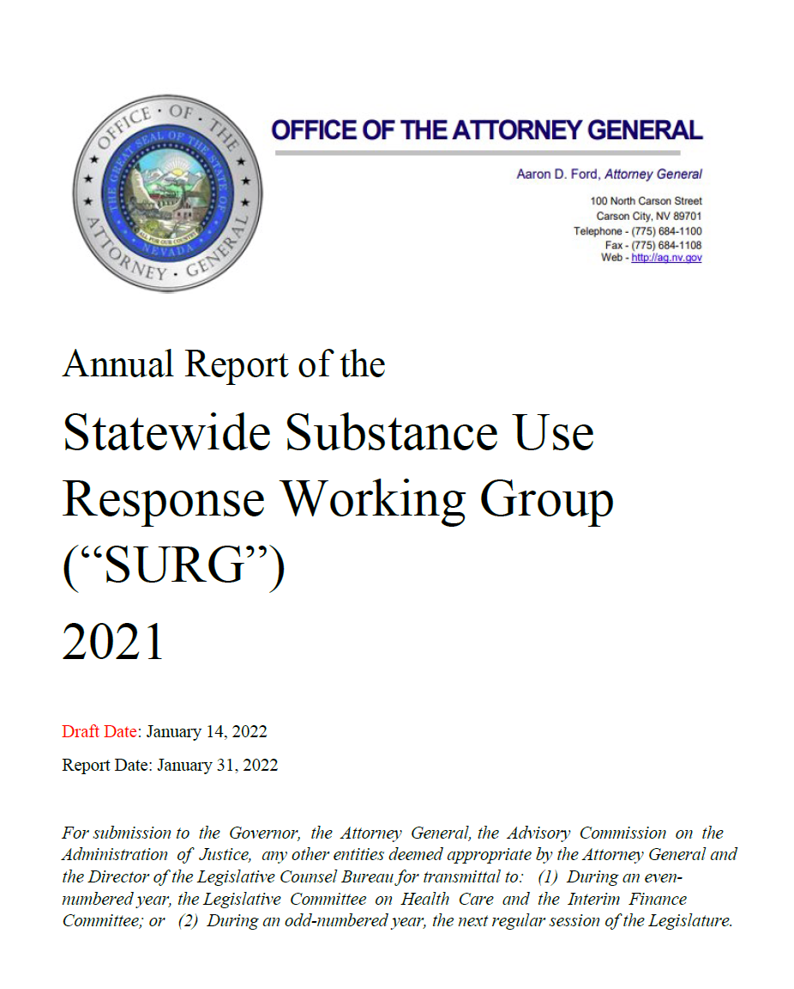
About the Report
The 2021 report provides an overview from statutes, lists membership, and summarizes the first meeting of the SURG.
Future annual reports will summarize findings and recommendations from the SURG.

Slide 45
Audience for the Report
“For submission to the Governor, the Attorney General, the Advisory Commission on the Administration of Justice, any other entities deemed appropriate by the Attorney General and the Director of the Legislative Counsel Bureau for transmittal to: (1) During an even-numbered year, the Legislative Committee on Health Care and the Interim Finance Committee; or (2) During an odd-numbered year, the next regular session of the Legislature”

Slide 46
Contents
Working Group Members and Non-Member Roles
Introduction & Background
Context for this Report
Roles and Responsibilities of the SURG
Update on Nevada’s Opioid Litigation
Recommendations for the Establishment, Maintenance, Expansion or Improvement of Programs to Address Substance Misuse and Substance Use Disorders
Appendix
Bylaws
SURG Members by Appointments
Members’ Biographical Information
Notes:
Enc

Slide 47
Statewide Substance Use Response Working Group (listed alphabetically)
Chelsi Cheatom Program Manager, Trac-B Exchange
Barbara Collins Principal, Mission High School, Clark County School District
Lesley Dickson Medical Director, Center for Behavioral Health
Fabian Doñate State Senator, District 10
Aaron Ford, Chair Attorney General, State of Nevada
Shayla Holmes Director, Lyon County Human Services
Jeffrey Iverson Director, Shine A Light Foundation
Jessica Johnson Senior Health Educator, Southern Nevada Health District (SNHD)
Lisa Lee Human Services Program Specialist, Washoe County Human Services Agency
Debi Nadler Co-founder, Moms Against Drugs
Christine Payson Nevada Sheriffs' and Chiefs' Association
Erik Schoen Executive Director, Community Chest, Inc.
Steve Shell Renown, Vice President, Behavioral Health, Renown Health
Claire Thomas State Assemblywoman, District 17
Dani Tillman Executive Director, Ridge House
Jill Tolles, Vice Chair State Assemblywoman, District 25
Stephanie Woodard Psy.D., State Mental Health Authority and Single State Authority for Substance Abuse

Slide 48
Context for Report
Assembly Bill 374 created the Statewide Substance Working Group within the Office of the Attorney General. This group (referred to as “SURG” or the “Working Group” throughout) is charged with comprehensively reviewing issues related to substance misuse and substance use disorders in Nevada.
Details of the bill and its requirements and documentation of activities of the SURG are available online.
The composition of the SURG is dictated in statutes. Appointments were made final in October 2021 and the first meeting of members convened November 16th, 2021.
The legislation (Section 10) requires specific reporting for and by the SURG.
“Section 10.5 of AB 374 bill requires the Department of Health and Human Services to annually report to the Working Group concerning the use of state and local money to address substance misuse and substance use disorders, and section 10 requires the Working Group to study, evaluate and make recommendations concerning the use of that money. Section 10 also requires the Working Group to submit annually a report of its recommendations to the Governor, the Attorney General, the Legislature and certain other entities.”
This report provides information from the first meeting of the Working Group in alignment with these requirements.
“Compile a report which includes, without limitation, recommendations for the establishment, maintenance, expansion or improvement of programs to address substance misuse and substance use disorders based on the evaluations conducted pursuant to subsection 1.”

Slide 49
Roles and Responsibilities of the SURG
The roles and responsibilities of the SURG are defined by statutes and are listed here:
Leverage and expand current efforts across departments and agencies to prevent and reduce substance use including, but not limited to heroin, opioid, and stimulant use and identify ways to enhance current efforts through coordination and collaboration.
Access evidence-based prevention and intervention efforts to significantly reduce the burden of substance use, including but not limited to heroin, synthetic and non-synthetic opioids, and stimulants. Recommendations must include:
primary, secondary, and tertiary prevention;
access to harm reduction interventions; and
overdose prevention strategies.

Slide 50
Roles and Responsibilities of the SURG
Assess and evaluate existing pathways to treatment and recovery for those who suffer from addiction including, but not limited to, special populations such as:
individuals who are incarcerated;
youth;
elderly;
pregnant women and the parents of dependent children;
people who inject drugs;
non-violent drug offenders whose crimes are primarily driven by addiction; and
disproportionately impacted populations.
Work to understand how Nevadans are able to access treatment and recovery supports from various points on the sequential intercept model. This includes a full review of Nevada’s existing law enforcement diversion, deflection and reentry programs.

Slide 51
Roles and Responsibilities of the SURG
Improve and expand evidence-based or evidence-informed programs, procedures and strategies to treat and support recovery from opioid use disorder and any co-occurring substance use disorder particularly in special populations such as:
individuals who are incarcerated;
youth;
elderly;
pregnant women and the parents of dependent children;
people who inject drugs;
non-violent drug offenders whose crimes are primarily driven by addiction; and
disproportionately impacted populations.
Support systems and programs for persons who are in recovery from opioid use disorder and any co-occurring substance use disorder.

Slide 52
Roles and Responsibilities of the SURG
Develop strategies and implementation plans between local, state and federal law enforcement entities and public health to prevent and respond to overdose.
Study the efficacy and expand implementation of programs available to educate youth and families about the effects of substance abuse, and programs aimed at reducing harms associated with drug use and referring to evidence-based treatment.
Improve coordination between local, state and federal law enforcement agencies and public health entities to enhance the communication of timely and relevant information and data and reduce duplicative data reporting and research activities.
Evaluate the current systems for sharing information between departments and agencies regarding the trafficking and distribution of licit and illicit substances including but not limited to stimulants, heroin and opioids.
Study the effect of substance abuse on the criminal justice system, including law enforcement and correctional facilities.
Study the sources and manufacturers of substances which are abused, as well as methods and resources to prevent the manufacture, trafficking and sale of substances which are abused.
Study the effectiveness of criminal and civil penalties in preventing substance abuse and the manufacture, trafficking and sale of substances which are abused.
Evaluate the impact of substance use disorder on the economy.

Slide 53
Update on Nevada’s Opioid Litigation
The Office of the Attorney General worked with Assemblywoman Tolles, Dr. Woodard and Tina Dortch, Program Manager, Nevada Office of Minority Health and Equity, to receive stakeholder involvement in how to utilize opioid settlement funds to overcome substance use issues for Nevada. Ultimately, the SURG will make recommendations for how to spend the funds.
Documents available include Declaration of Findings; Contingency Fee Contract, Second Amended Complaint, and One Nevada Agreement on Allocation of Opioid Recoveries.
The Declaration of Findings was established by the Governor to require outside counsel as a large and complex complaint suing over 60 entities. The Bureau of Consumer Protection directed the process to publish a Request for Proposals for law firms, with responses across the state and the country. The selection committee was diverse with members across the state to review and score the law firms.
The Second Amended Complaint allows the Office of Attorney General to add defendants as the discovery process continues, collecting information from defendants and other stakeholders.
The One Nevada Agreement allows the state to fairly and equitably allocate recovery from litigation between political subdivisions. Although the state’s trial date is ahead of county trial dates, the Office of the Attorney General is approaching this as a statewide effort in concert with the counties. All 17 Nevada counties agreed to participate, even if the county does not have current litigation, as well as all cities that are in litigation. State funds go to the Fund for Resilient Nevada according to state law. The SURG will then make recommendations to support the State Plan and Needs Assessment for how to best address the opioid epidemic in different parts of the state.

Slide 54
Update on Nevada’s Opioid Litigation
Process Notes and Next Steps
Nevada’s case is unique because it includes defendants who were manufacturers, distributors and pharmacies involved in this opioid epidemic.
The Office of the Attorney General is currently in the discovery phase and the amount of documents Nevada has turned over is extensive including documents from the Department of Health and Human Services (DHHS), the Department of Public Safety (DPS) and others at 15 million pages and over three terabytes of data.
The trial date of April 17, 2023 is soon in terms of litigation.
The state will not receive one lump sum from the defendants, some of whom have declared bankruptcy. The process and timing of recovering damages for harm created is going to be different if a case is settled versus goes to trial. The monies that will come in will be staggered.
Courts may rule that money will come in over a series of years, depending on the lawsuits with different defendants. The account (Fund for Resilient Nevada) can accept funds from various sources. For example, if a doctor is determined to have mis-prescribed drugs, the State could ask for restitution to be paid to this account.

Slide 55
Recommendations for the Establishment, Maintenance, Expansion or Improvement of Programs to Address Substance Misuse and Substance Use Disorders
November 16th, 2021 marked the inaugural meeting of the SURG, and the agenda focused on setting up structural aspects of the process. For this reason, this report is limited in its discussion of recommendations for establishment, maintenance, expansion, or improvement of programs.
More robust recommendations will be developed in future meetings.
Decisions of the SURG included motions to nominate Attorney General Aaron Ford as Chair, which received unanimous support. Assemblywoman Tolles was nominated and unanimously approved as Vice Chair.
The draft bylaws were approved, with one change: from Article 3, Section 1. Lisa Lee requested a change from the term “Intravenous drug users,” to people first language, such as “people who inject drugs.” The motion to approve the amended bylaws also passed unanimously.
The SURG also discussed how to frame upcoming discussions. Dr. Woodard put forward a potential set of topics:
Substance Use Prevention
Reducing Harms
Early Intervention and Treatment
Recovery Supports
Criminal Justice
Data and Information Sharing

Slide 56
Recommendations for the Establishment, Maintenance, Expansion or Improvement of Programs to Address Substance Misuse and Substance Use Disorders
Members of the SURG discussed and provided input on this framework. More detail can be found in the minutes of the meeting. Suggestions for the process are summarized below:
Meeting Considerations
Organizing Topics. It was suggested to group the six topics two at a time for meetings throughout the rest of 2022.
Timing Considerations. Bill draft requests (BDRs) will be due well before the January 2023 deadline, but discussions can help inform that process.
Meeting Length. Two to three hours was suggested as a minimum amount of time for a single topic. Longer meetings were also suggested, with a proposal for four-hour meetings, starting at 9 a.m., including a lunch break, and covering two hours per topic.
Subcommittees. Subcommittees were suggested as a possibility to support a deeper analysis of information by topic. Subcommittees will be considered as a potential strategy to study the issues.
Data. Data will be important in future presentations.
Subject Matter Experts (SME) will present on topic areas.
Regional Information. Information by region, including what has been successful, was suggested as a way to identify what to continue or what might be new or innovative.
Prioritization. Members were asked to keep in mind the number of meetings that would be required. It is unlikely the group will be able to accomplish everything ahead of the 2023 legislative session, prioritization will be critical.

Slide 57
Discussion on Specific Topics
Suggestions made by members include
Criminal Justice: Committee members discussed several models to better examine this category, including the sequential intercept model of pre-justice system versus re-entry programs and strategies within the community, as well as dividing criminal justice areas into three categories: pre-incarceration, incarceration treatment, and then re-entry programs.
Prevention: Children and youth should have considerable attention; prevention and early intervention for children was discussed as needing more time. Jessica Johnson referenced the Institute of Medicine’s Continuum of Care for substance abuse, suggesting the SURG discuss universal prevention efforts and some selected secondary prevention efforts. Reducing harm is kind of a tertiary prevention effort, before getting to a diagnosis, which would then qualify as treatment. One strategy might be to explore health promotion and prevention, so reducing harm could be grouped in that way in one presentation. Early intervention and treatment, and recovery support could be a second grouping. Under the criminal justice topic, there are opportunities for information and data sharing. There may be some overlap from a public health perspective and there may be important recommendations from SME.
Social Determinants of Health: Social determinants of health (SDOH) that impact peoples’ experiences and cycles of isolation and poverty that impact substance use should be included. SDOH in rural Nevada was also noted as an important need for capacity.
Child Welfare System and Substance Use: This category should be viewed separately from the criminal justice system. For opioid use in particular, recently published research shows a correlation between overdose rates increasing where child welfare rates increase in communities. There are efforts across the state to incorporate CARA Plans of Care as well as the Families First Prevention Services Act.
Overdose Prevention: This topic would deserve its own place on the agenda.

Slide 58
Discussion on Specific Topics
Next Steps
Suggesting Topics and Subtopics. Members were advised to keep their Bylaws available and to attach agenda suggestions to items A-Q from the bylaws and legislation, to determine where it fits in their scope.
Needs Assessment. State contracted vendors will bring forward initial findings for the Needs Assessment to the January meeting.

Slide 59
Appendices
Bylaws
SURG Members by Appointments
SURG Member Biographical Information

Slide 60
Questions or Comments

Slide 61
Action

Slide 62
7. Establish Priorities and Process for the Upcoming Year to Accomplish the Business of the Working Group
(For Possible Action.)

Slide 63
8. Review and Consider Items for March 9, 2022 SURG Meeting

Slide 64
9. Public Comment.
(Discussion only.)

Slide 65
Public Comment
Public comment shall be limited to three (3) minutes per person. We will begin with comments from Las Vegas and then invite comments from Carson City, followed by online participants.
In Person
Please form a line.
Before commenting, please state your full name for the record.
Notes:
Limit public comment timing –
Vegas
Carson
Online
--

Slide 66
Public Comment
Attending Online
Please use the “raise hand” feature to indicate you would like to provide public comment so the host can prompt you to unmute.
If you are dialing in from a telephone and would like to provide public comment, please press *9 so the host can prompt you to unmute.
Before commenting, please state your full name for the record.
Notes:
Limit public comment timing –
Vegas
Carson
Online

Slide 67
Public Comment
Comments can also be emailed to lhale@socialent.com. These comments and questions will be recorded in meeting minutes.
Notes:
Limit public comment timing –
Vegas
Carson
Online

Slide 68
10. Adjournment.
(Discussion only.)

Slide 69
Additional Information, Resources & Updates Available At:
https://ag.nv.gov/About/Administration/Substance_Use_Response_Working_Group_(SURG)/

